Slide 3
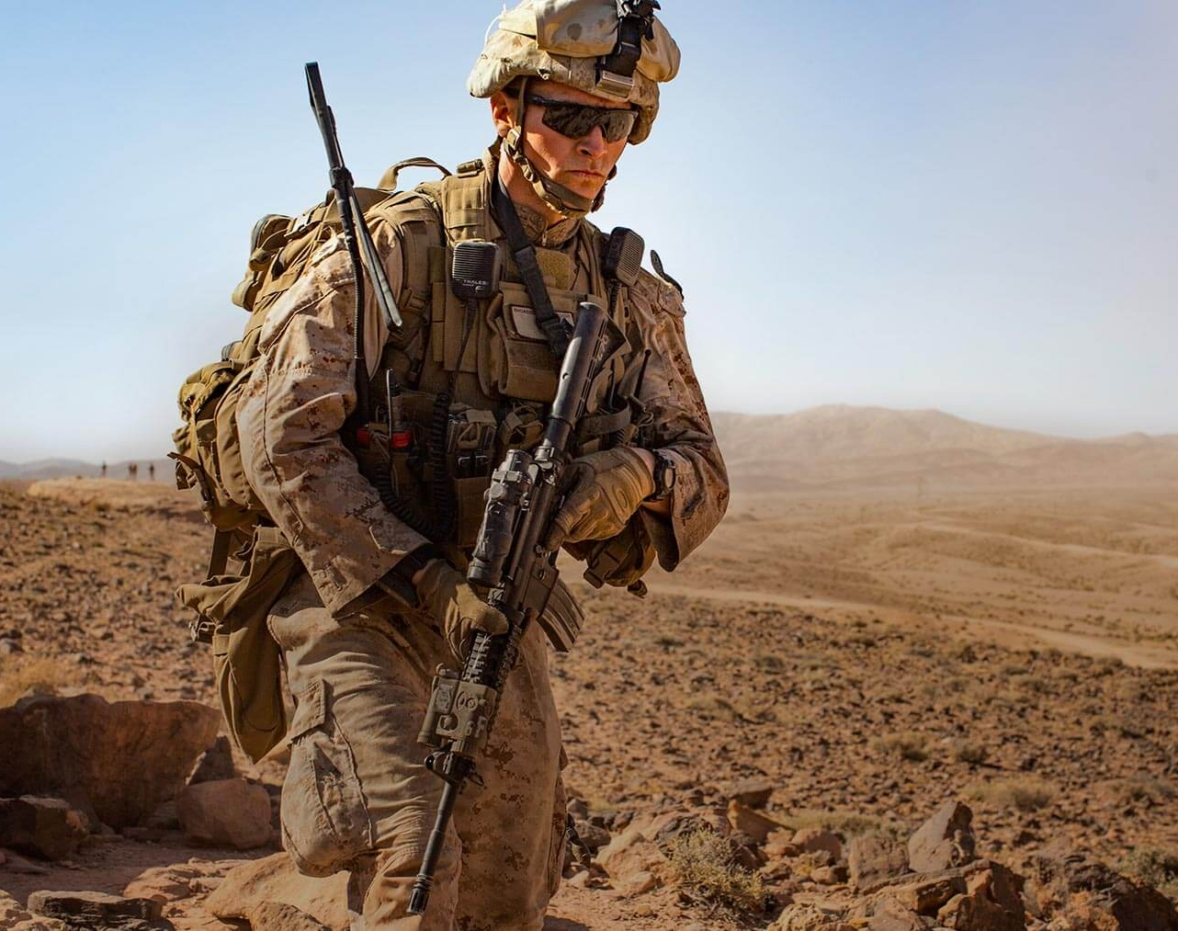
Commander’s Orders: Put on Full Body Armor of God
Warfare Principle:
Armor on = we can discern and stand against the schemes of the devil.

Slide 4
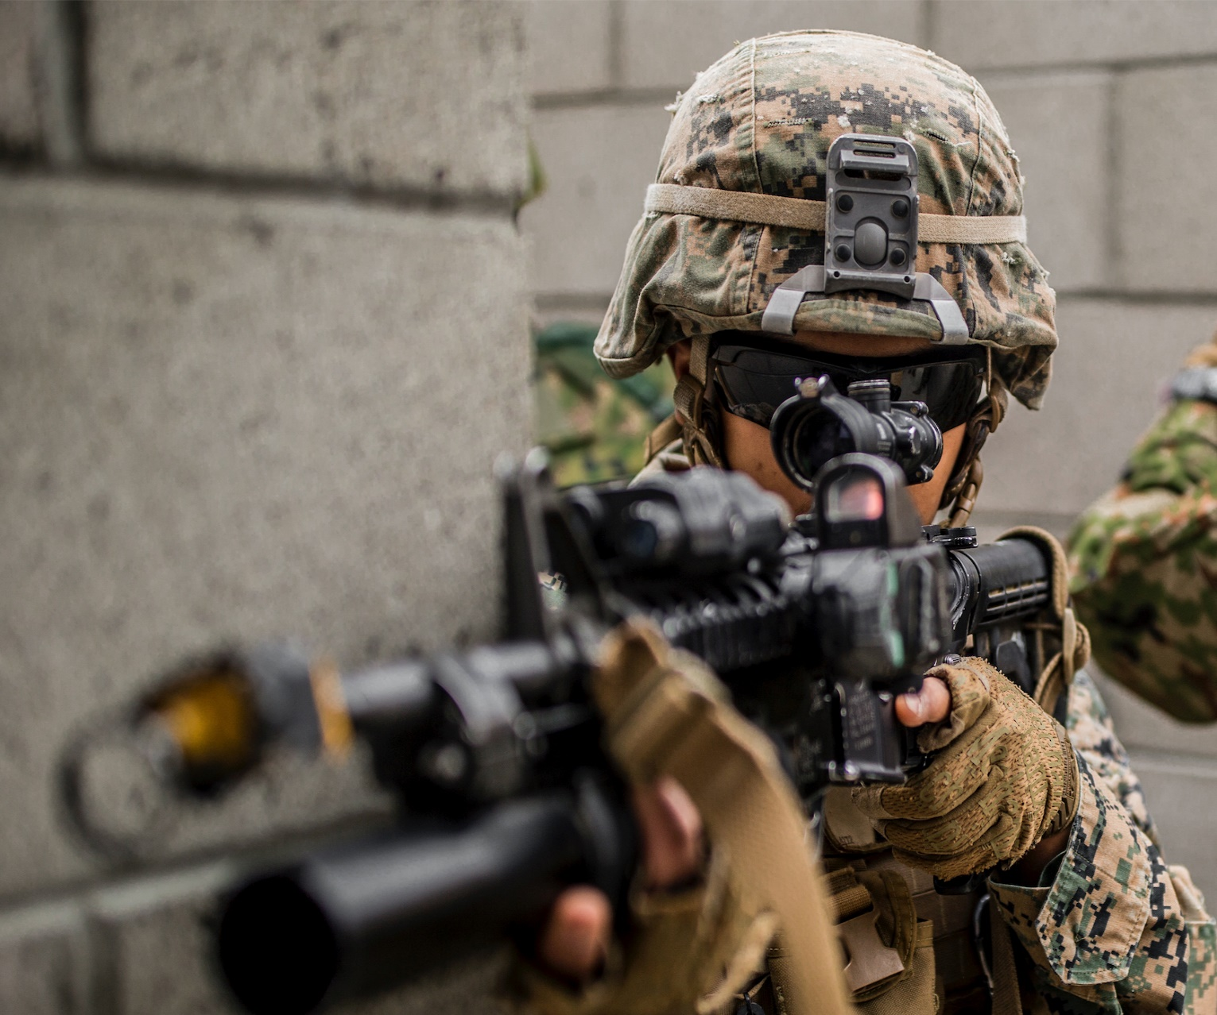
Why do we need the Armor of God?
Protection — when under attack
Position — in God’s victorious army
Power — against unseen enemy
Our Goal: Wear the Armor of God daily so that we can stand firm in the battle.

Slide 5
Armor is for protection of our valuable, priceless life in Christ.
Because we are Christ’s (Ephesians 1)
Chosen one’s (1:4)
Adopted as His Royal Children (1:5)
The Redeemed Ones (1:7)
Christ’s treasure and inheritance (1:11)
Vessels sealed by the Holy Spirit (1:13)
The living Body of Christ on earth (1:23)

Slide 6
We have been given the position that Satan coveted — seated with Christ in the heavens. (Ephesians 2:6)
Ephesians 2:3-6
But God, being rich in mercy, because of His great love with which He loved us, even when we were dead in our transgressions, made us alive together with Christ (by grace you have been saved), and raised us up with Him, and seated us with Him in the heavenly places in Christ Jesus…

Slide 7
We are a high value target because we have been rescued from Satan’s prison.
Colossians 1:13-14
For He rescued us from the domain of darkness, and transferred us to the kingdom of His beloved Son, in whom we have redemption, the forgiveness of sins.

Slide 8
Our Lord gives us His authority and power.
Luke 9:1
And He called the twelve together, and gave them power and authority over all the demons and to heal diseases.
Ephesians 1:19
I pray that the eyes of our heart be open to so we may know what is the immeasurable greatness of HIS power to us who believe.
We have the same power in us that raised Jesus from the dead!!
Do you think Satan wants you to exercise this power and authority against him?

Slide 9
We are God’s army on earth.
We are to bring destruction to Satan’s kingdom and take no prisoners.
Our mission is to proclaim destruction to the rulers and powers of darkness in Christ’s authority and power.
Ephesians 3:10
This is so God’s multifaceted wisdom may now be made known through the church (you and me) to the rulers and authorities in the heavens.

Slide 10
KEY TRUTH:
The Lord Jesus Christ is our armor.
LEARNING OBJECTIVE:
To understand and apply the full armor of God so that we can stand firm in the battle against Satan and to discern his schemes.
KEY VERSE:
Ephesians 6:11 – “Put on the full armor of God, that you may be able to stand firm against the schemes of the devil.”

Slide 11
The Armor of God
Ephesians 6:10-18
Finally, be strong in the Lord and in the strength of His might. Put on the full armor of God, so that you will be able to stand firm against the schemes of the devil. For our struggle is not against flesh and blood, but against the rulers, against the powers, against the world forces of this darkness, against the spiritual forces of wickedness in the heavenly places.

Slide 12
The Armor of God
Ephesians 6:10-18
Therefore, take up the full armor of God, so that you will be able to resist in the evil day, and having done everything, to stand firm.
Stand firm therefore, HAVING GIRDED YOUR LOINS WITH TRUTH, …

Slide 13
The Armor of God
Ephesians 6:10-18
and HAVING PUT ON THE BREASTPLATE OF RIGHTEOUSNESS, …
and having shod YOUR FEET WITH THE PREPARATION OF THE GOSPEL OF PEACE; …

Slide 14
The Armor of God
Ephesians 6:10-18
in addition to all, taking up THE SHIELD OF FAITH with which you will be able to extinguish all the flaming arrows of the evil one.
And take THE HELMET OF SALVATION, and the SWORD OF THE SPIRIT, which is the word of God.

Slide 15
The Armor of God
Ephesians 6:10-18
With all prayer and petition pray at all times in the Spirit, and with this in view, be on the alert with all perseverance and petition for all the saints, …

Slide 16
What is the Purpose of the Full Armor of God?

Slide 17
Understanding the Armor of God
GROUP DISCUSSION: Each group will take one piece of the Armor and with your study books and Bible, answer these questions:
What this is the purpose of this piece of Armor in battle? Define the key word, i.e. ‘Truth’, ‘Faith’, etc. You may use a Bible verse.
What is the application of this piece of Armor in my life? Give an example.
(10 minutes and then discussion)

Slide 18
Finally, be strong in the Lord and in his mighty power. (Ephesians 2:6)
2 Corinthians 12:9-10
Therefore, I will most gladly boast all the more about my weaknesses, so that Christ’s power may reside in me … for when I am weak then I am strong.
Psalm 18:32, 39
God—clothes me with strength and makes my way perfect. ... You have clothed me with strength for battle.

Slide 19
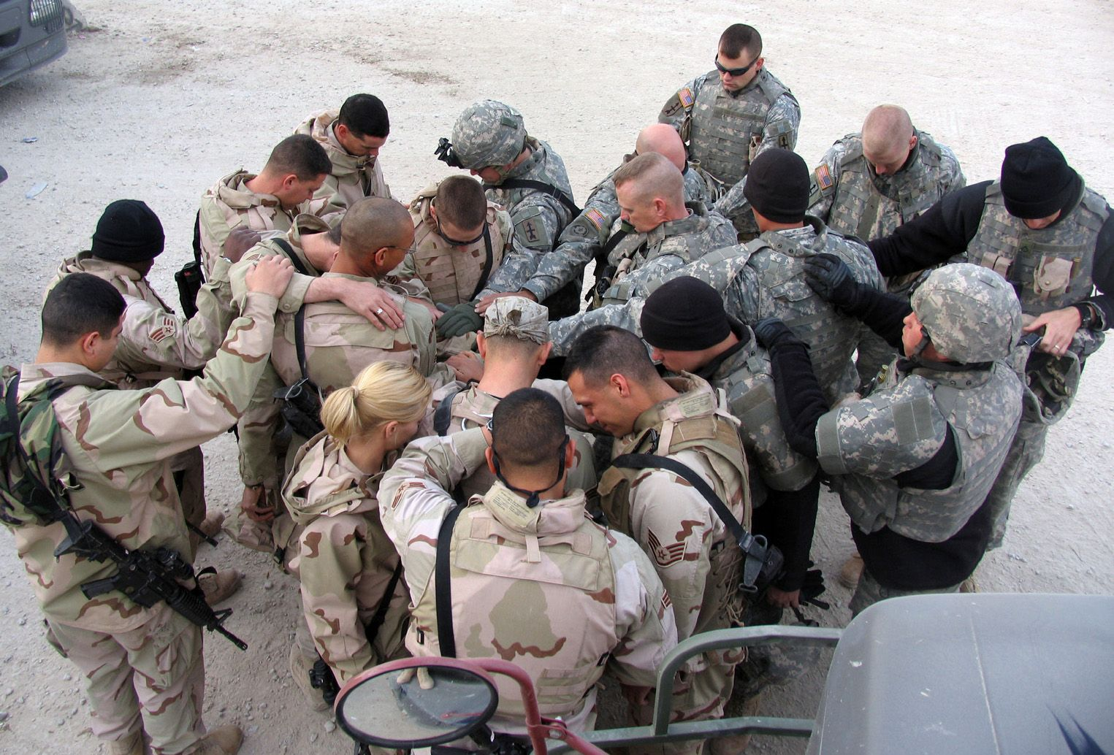
Our weapons are supernatural.
2 Corinthians 10:4-5
For the weapons of our warfare are not of the flesh but have divine power to destroy strongholds. We destroy arguments and every lofty opinion raised against the knowledge of God, and take every thought captive to obey Christ,

Slide 20
Put on the full armor of God, so that you will be able to stand firm against the schemes of the devil. (Ephesians 6:11)
When we put on the full armor of God, we will discern and stand firm against the schemes of the devil.
What are the devil’s schemes or tactics that work in your life?
Identify on scheme working against you now.

Slide 21
For our battle is not against flesh and blood, … (Ephesians 6:12)
Our non-enemies are flesh and blood:
Spouses, boyfriend or girlfriend
Children and step-children
Relatives
Boss
Friends who betray you
How much time do we spend fighting in our own strength the wrong enemy and losing most of the time?

Slide 22
But against the rulers, against the powers, against the world forces of this darkness, against the spiritual forces of wickedness in the heavenly places. (Ephesians 6:12b)
Satan’s military hierarchy:
Satan
Rulers, powers, principalities over nations
World forces over systems of evil
Forces of wickedness

Slide 23
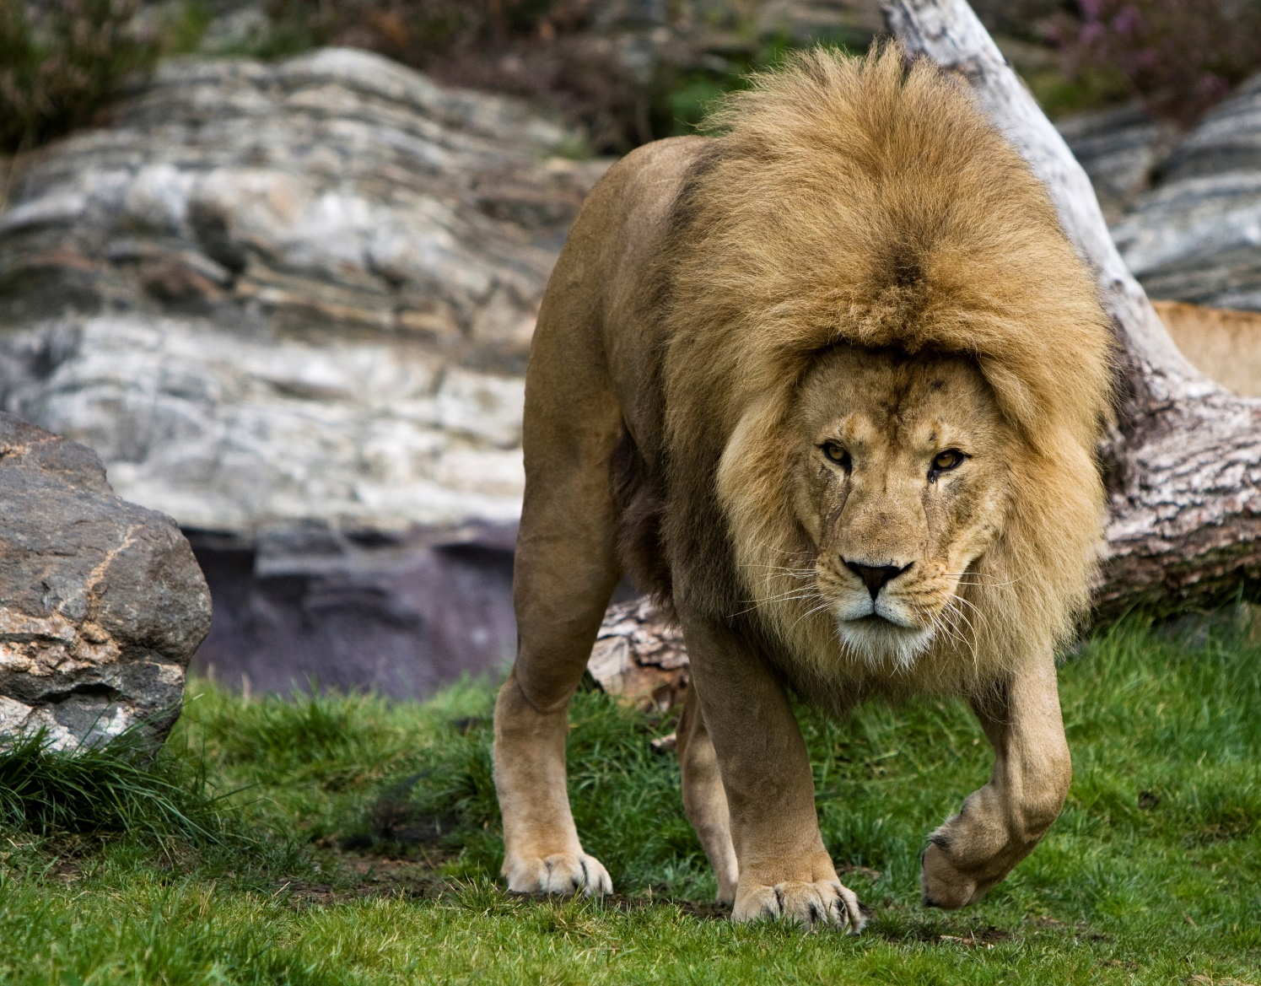
Our Adversary is not made of flesh and blood.
Our true reality is in the unseen world.
Spiritual Warfare
1 Peter 5 (CJB)
Stay sober, stay alert! Your enemy, the Adversary, stalks about like a roaring lion looking for someone to devour.
Isaiah 14:12-15
Ezekiel 28:11-15

Slide 24
Our battle is against Satan and the demonic hosts of hell. (Ephesians 6:12)
Satan’s kingdom is an unseen military hierarchy designed to:
Keep the unbeliever from Christ (2 Corinthians 4:3-5)
Attack and defeat us as Christians using three major avenues:
The sinful appetites of the flesh — Victory is by the Cross (Romans 6:6-7, Galatians 5:24)
The lusts for the things of the world — Victory is by the Cross (Galatians 6:14)
The devil and demons — Victory is by using our divine weapons (Ephesians 6:12-13; Revelation 12)

Slide 25
Take up the full armor of God, that you may be able to resist in the evil day, having done everything, to stand firm. (Ephesians 6:13)
Take up — to seize and put on armor in order
Full armor — every facet of Christ
Evil days — times of severe attack
Job stood firm in the evil days and was equipped to minister.
The warfare you face will serve God’s purpose.

Slide 26
Put on the Lord Jesus Christ.
Romans 13:14
But put on the Lord Jesus Christ, and make no provision for the flesh, to gratify its desires.

Slide 27
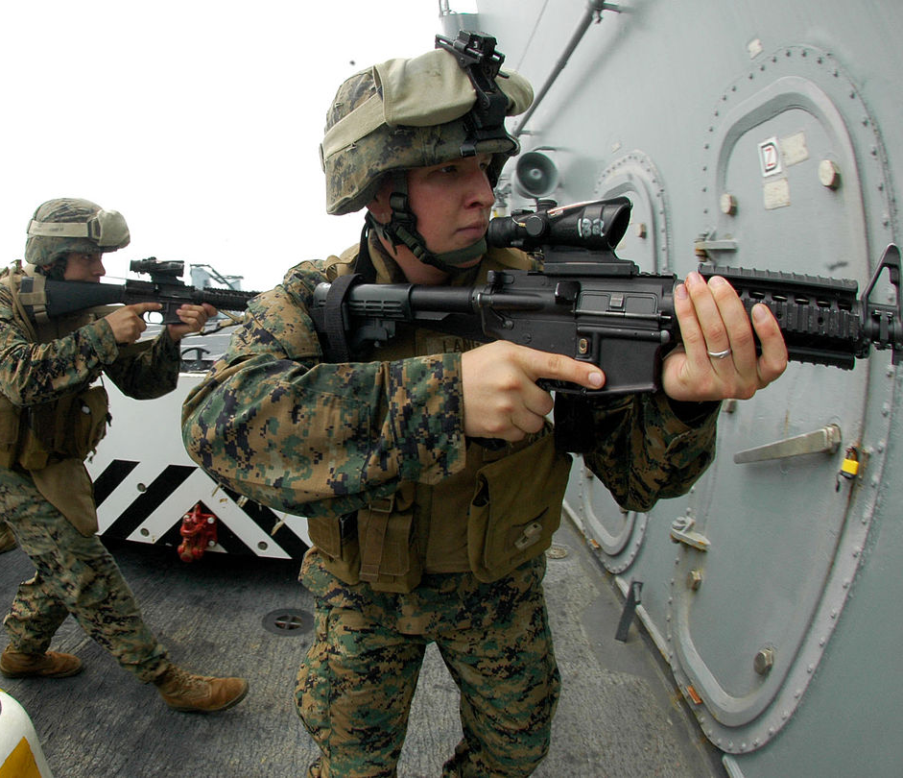
We will be able to resist and stand firm in the evil day when we wear the full armor of God.
Warfare Principle:
The putting on of every piece of the Armor helps us to stand in victory under demonic attack.

Slide 28
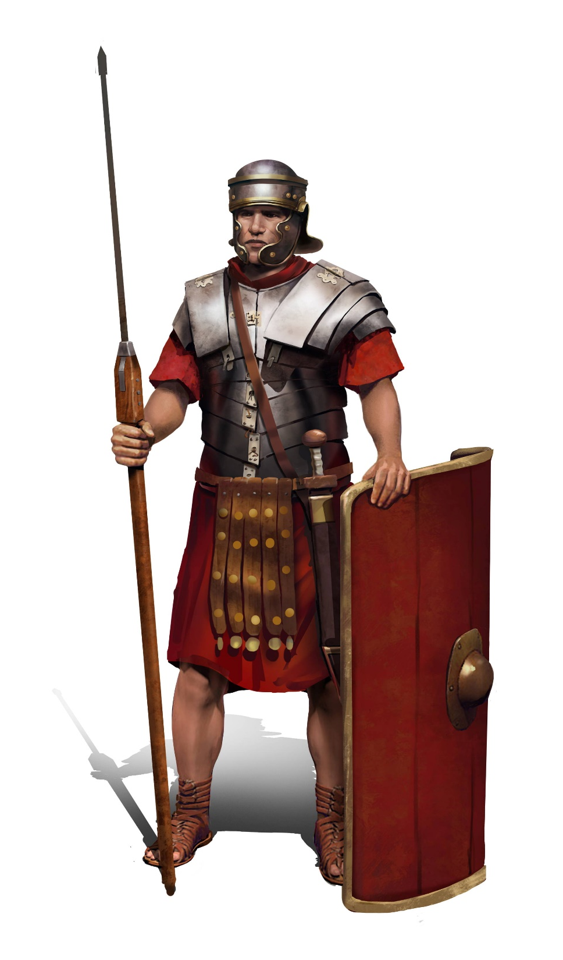
7 Pieces of Spiritual Armor
Belt of Truth
Breastplate of Righteousness
Feet sandaled and ready to go and proclaim the Gospel of Peace
Shield of Faith
Helmet of Salvation
Sword of the Spirit — the Word of God
Prayer
Spiritual Warfare

Slide 29
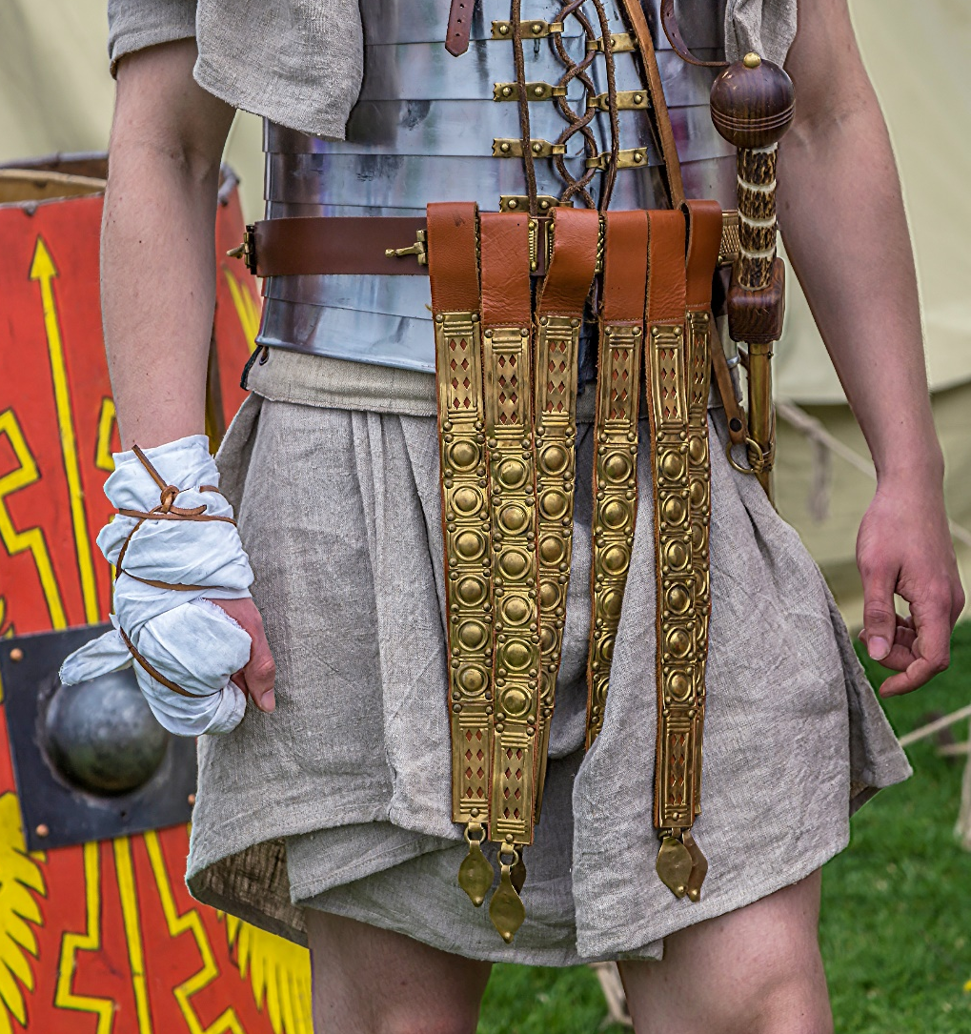
Therefore, stand! Have the belt of truth buckled around your waist.
(Ephesians 6:14)
PURPOSE:
To stand in military position
Protect us from enemy lies
Defeat demonic lies with truth
Jesus answered, “I am the way, the truth, and the life. The only way to the Father is through me.”

Slide 30
Making Truth our Belt.
(Ephesians 6:14)
APPLICATION:
The belt of truth is activated when we take an unwavering stand on God’s Word in the face of lies.
Truth — to walk in the Light with God and others in the Body of Christ.

Slide 31
1 John 1:10
This is the message we have heard from Him and announce to you, that God is Light, and in Him there is no darkness at all. If we say that we have fellowship with Him and yet walk in the darkness, we lie and do not practice the truth; but if we walk in the Light as He Himself is in the Light, we have fellowship with one another, and the blood of Jesus His Son cleanses us from all sin.

Slide 32
The Weapon of Truth
John 8:31-33
So Jesus was saying to those Jews who had believed Him, "If you continue in My Word, then you are truly disciples of Mine; and you will know the truth, and the truth will make you free."

Slide 33
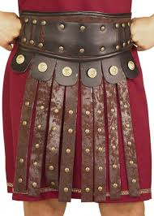
Stand, … with righteousness like armor on your chest, …
(Ephesians 6:14)
PURPOSE:
Protect us from enemy accusations about our past sin by using guilt or shame.
Protect our heart.
Righteousness — right standing before God because our sin debt was paid for and cancelled by our Lord Jesus Christ.

Slide 34
I receive Christ’s righteousness.
(Ephesians 6:14)
Philippians 3:8-9
…that I may gain Christ, and may be found in Him, not having a righteousness of my own derived from the Law, but that which is through faith in Christ, the righteousness which comes from God on the basis of faith.

Slide 35
Activating the “breastplate of righteousness”.
(Ephesians 6:14)
APPLICATION:
When we purpose in our heart not to be defiled by sin, and we claim the righteousness of Christ as ours, we stand strong against Satan’s accusations.

Slide 36
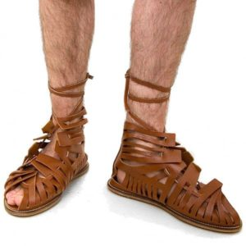
… on your feet the readiness that comes from the GOSPEL OF PEACE.
(Ephesians 6:15)
PURPOSE:
To hold you firmly in place when you are getting hit, never backing down once you have engaged the enemy.
Gospel of Peace — is Christ’s salvation and victory for us by reconciling us to God.

Slide 37
… on your feet the readiness that comes from the GOSPEL OF PEACE.
(Ephesians 6:15)
APPLICATION:
“I declare that I have been purchased with the precious Blood of Christ. The record of my sin has been cancelled. I stand in the righteousness of Christ. I am at peace with God. I choose to forgive all who have offended me with the forgiveness of my Lord Jesus Christ, and I cancel their record of wrongs against me. I stand firmly in the Gospel of peace and claim the boldness of Christ to declare the Gospel.”

Slide 38
… on your feet the readiness that comes from the GOSPEL OF PEACE.
(Ephesians 6:15)
PURPOSE:
To hold you firmly in place when you are getting hit, never backing down once you have engaged the enemy.
Gospel of Peace — is Christ’s salvation and victory for us by reconciling us to God.

Slide 39
… on your feet the readiness that comes from the GOSPEL OF PEACE.
(Ephesians 6:15)
APPLICATION:
“I declare that I have been purchased with the precious Blood of Christ. The record of my sin has been cancelled. I stand in the righteousness of Christ. I am at peace with God. I choose to forgive all who have offended me with the forgiveness of my Lord Jesus Christ, and I cancel their record of wrongs against me. I stand firmly in the Gospel of peace and claim the boldness of Christ to declare the Gospel.”

Slide 40
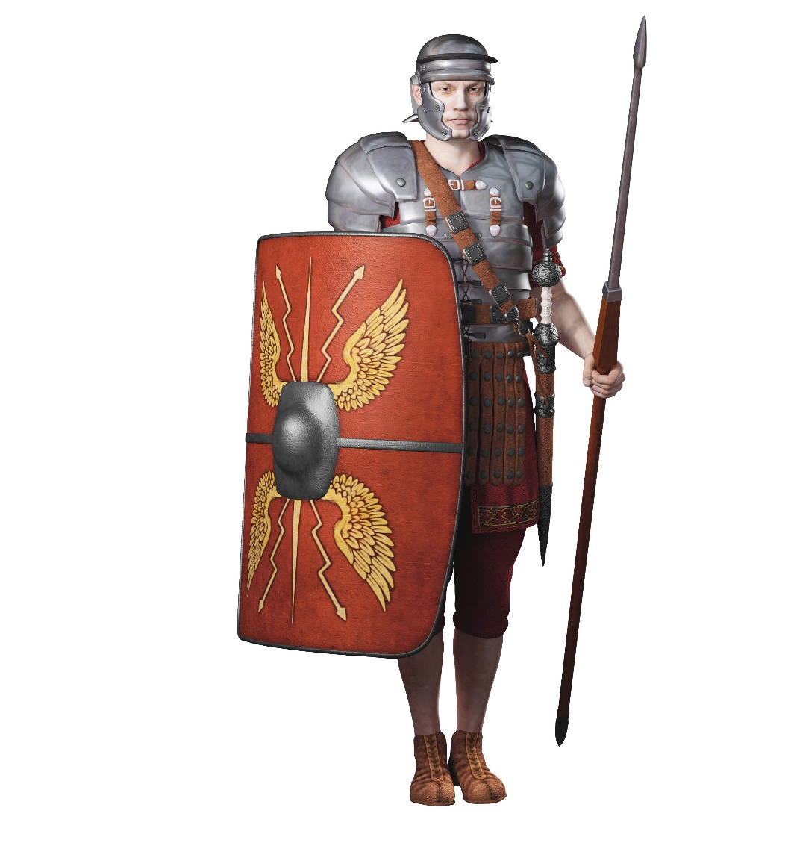
Above all take up the SHIELD OF FAITH so that you can extinguish all the flaming arrows of the evil one.
(Ephesians 6:16)
PURPOSE:
Keeps us standing by God’s Word when flaming unclean, sinful, accusing thoughts come against us
Faith — is a personal trust in the person of the Lord Jesus Christ for our every need and circumstance. It is seeing thru’ Christ’s eyes.

Slide 41
Standing by Faith
Colossians 2:6-7 (NASB)
Therefore as you have received Christ Jesus the Lord, so walk in Him, having been firmly rooted and now being built up in Him and established in your faith, just as you were instructed, and overflowing with gratitude.

Slide 42
The Lord is our shield.
Psalm 3:2-3
Many are rising up against me.
Many are saying of my soul,
"There is no deliverance for him in God." Selah.
But You, O LORD, are a shield about me,
My glory, and the One who lifts my head.

Slide 43
Activating the “shield of faith”.
(Ephesians 6:16)
APPLICATION:
We choose to believe God’s Word even when it does not agree with our perceptions, emotions, circumstances or the enemy’s lies.

Slide 44
What are 5 ways to use the shield of faith?
Spiritual Warfare
Intake God’s Word.
Claim God’s promises.
Be filled with the Holy Spirit.
Put up your shield immediately in combat.
Be occupied with Christ.
Colossians 3:1-2
Since, then, you have been raised with Christ, set your hearts on things above, where Christ is, seated at the right hand of God. Set your minds on things above, not on earthly things.

Slide 45
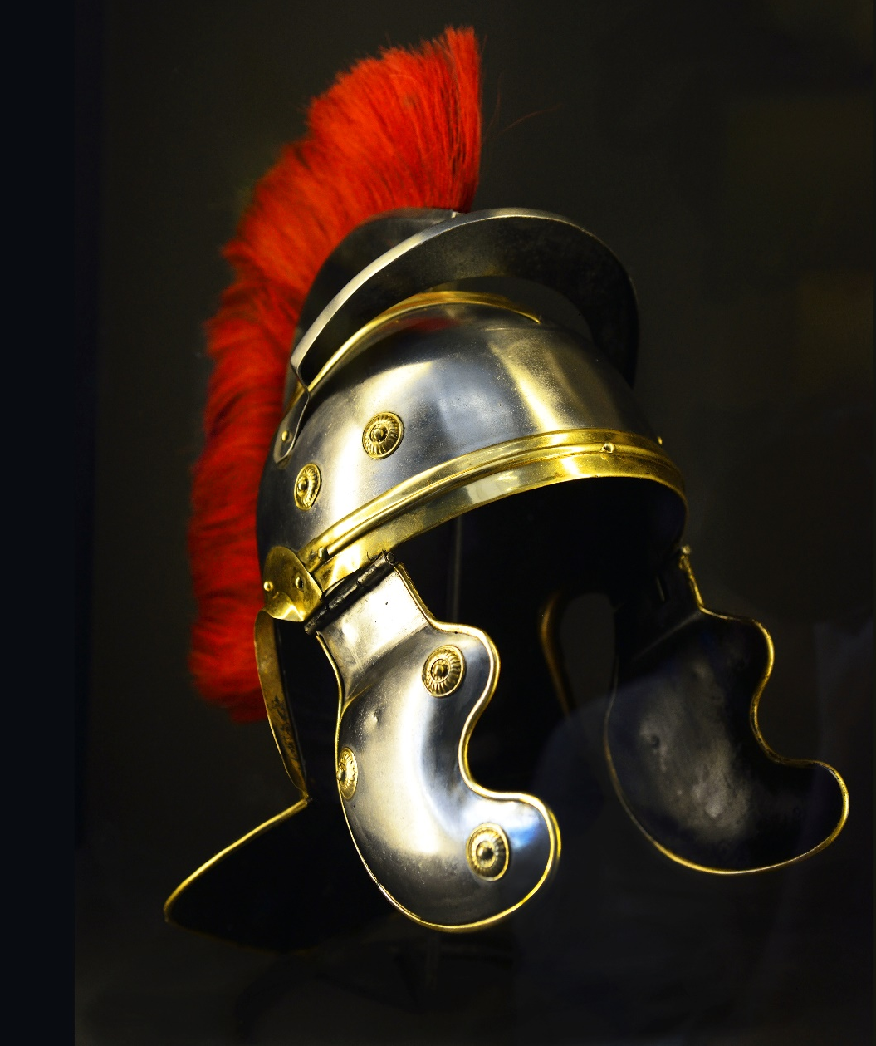
“Take the HELMET OF SALVATION.” (Ephesians 6:17)
PURPOSE:
We are identified as a child of God having been delivered from the kingdom of darkness.
Salvation — forgiven of my sin, rescued from the enemy camp, given victory over the world and devil and given a permanent place in God’s family / army.

Slide 46
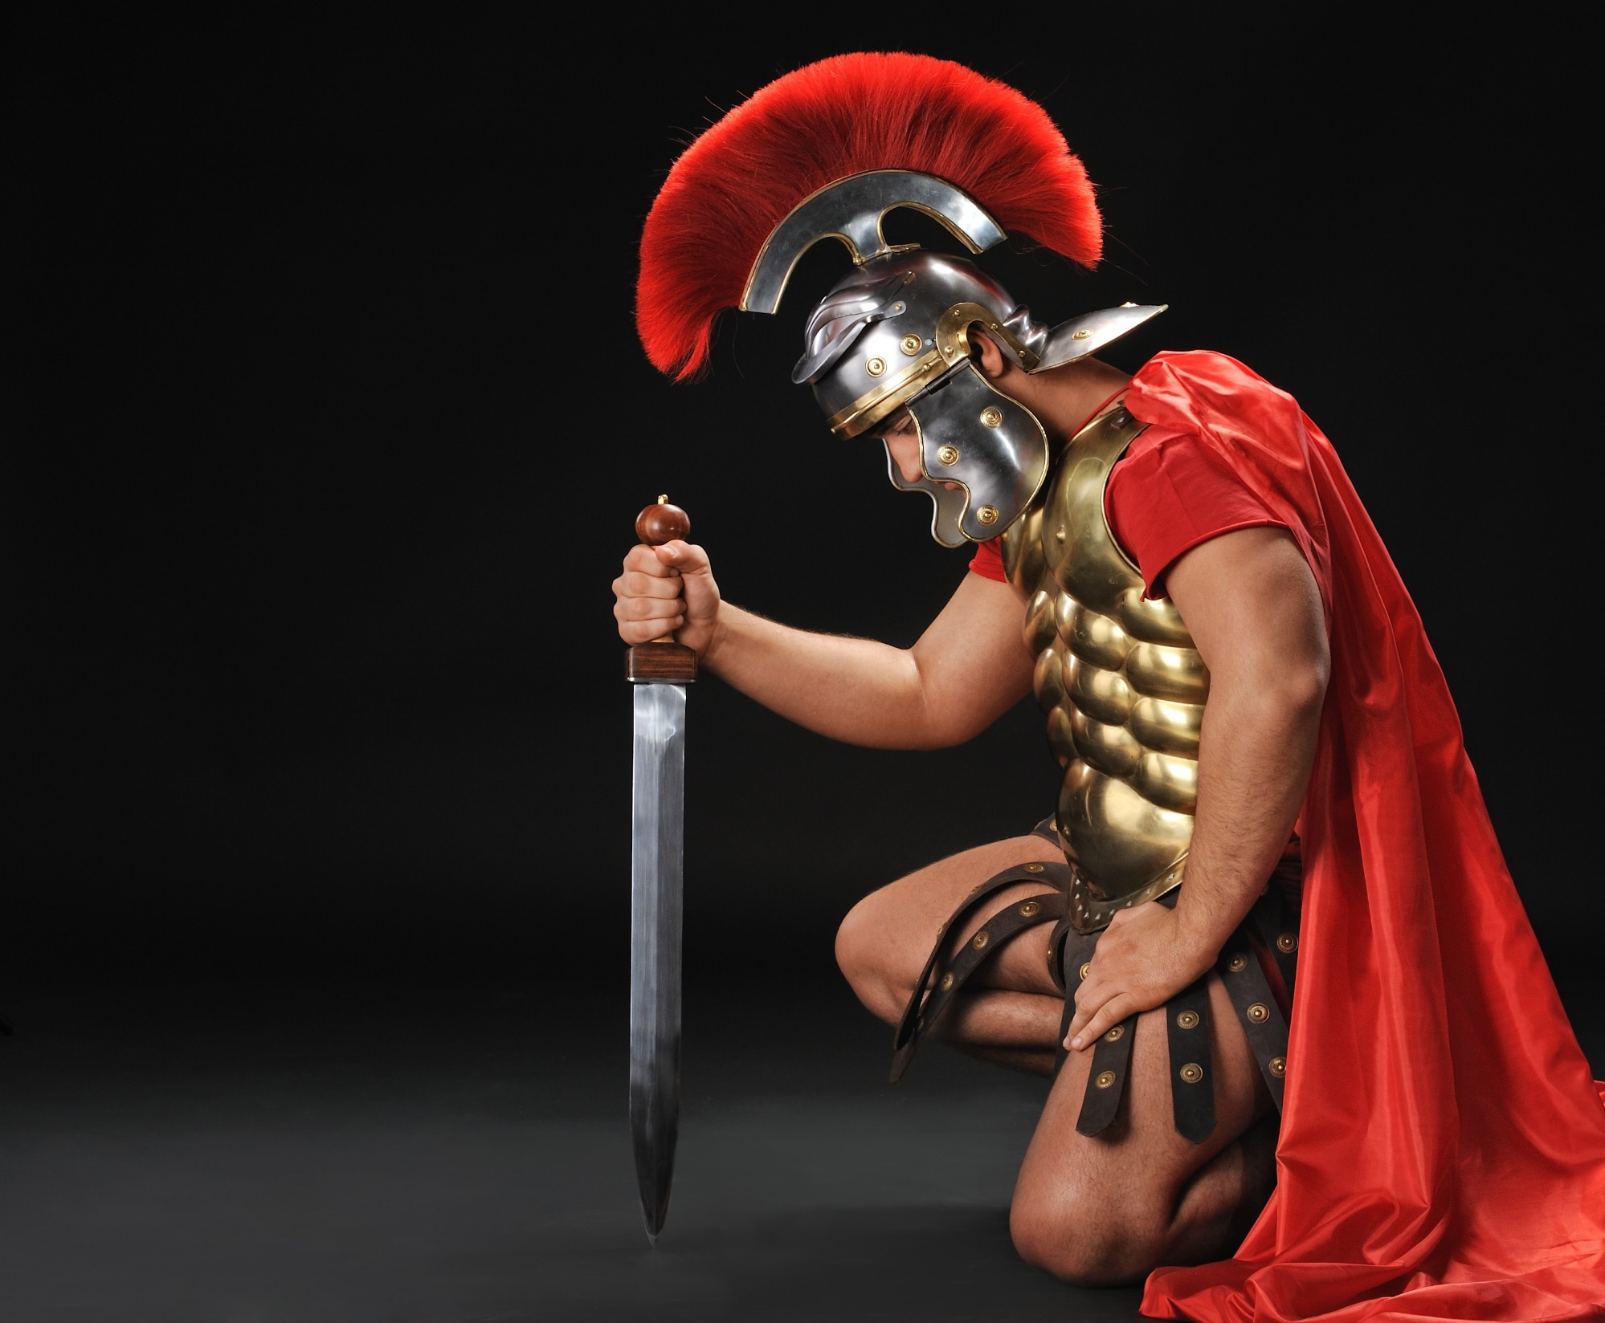
Why the Roman Helmet?
Spiritual Warfare
Identified which army
Red crested – identifies us as Soldiers of the Cross
We march under the Blood of the Lamb

Slide 47
Our Lord won our victory with this battle proven helmet.
Spiritual Warfare
Isaiah 59:17
He put on righteousness like a breastplate,
And a helmet of salvation on His head;

Slide 48
The mind is the battlefield
Our enemy inserts in our mind his lies, evil imaginations, high reasoning, doubts, etc.
Enemy fortresses are destroyed at deliverance.
Now the mind must be restored with God’s truth.
More in Chapter 5.

Slide 49
Divinely powerful weapons
For though we walk in the flesh, we are not waging war according to the flesh. For the weapons of our warfare are not of the flesh but have divine power to destroy strongholds. We destroy arguments and every lofty opinion raised against the knowledge of God, and take every thought captive to obey Christ, being ready to punish every disobedience, when your obedience is complete.

Slide 50
Activating the “helmet of salvation” (Ephesians 6:17)
APPLICATION:
Refuse the evil thought when first hits.
Distinguish between enemy thoughts and your own.
Speak the truth in place of the lies.
Submit your emotions to Christ.

Slide 51
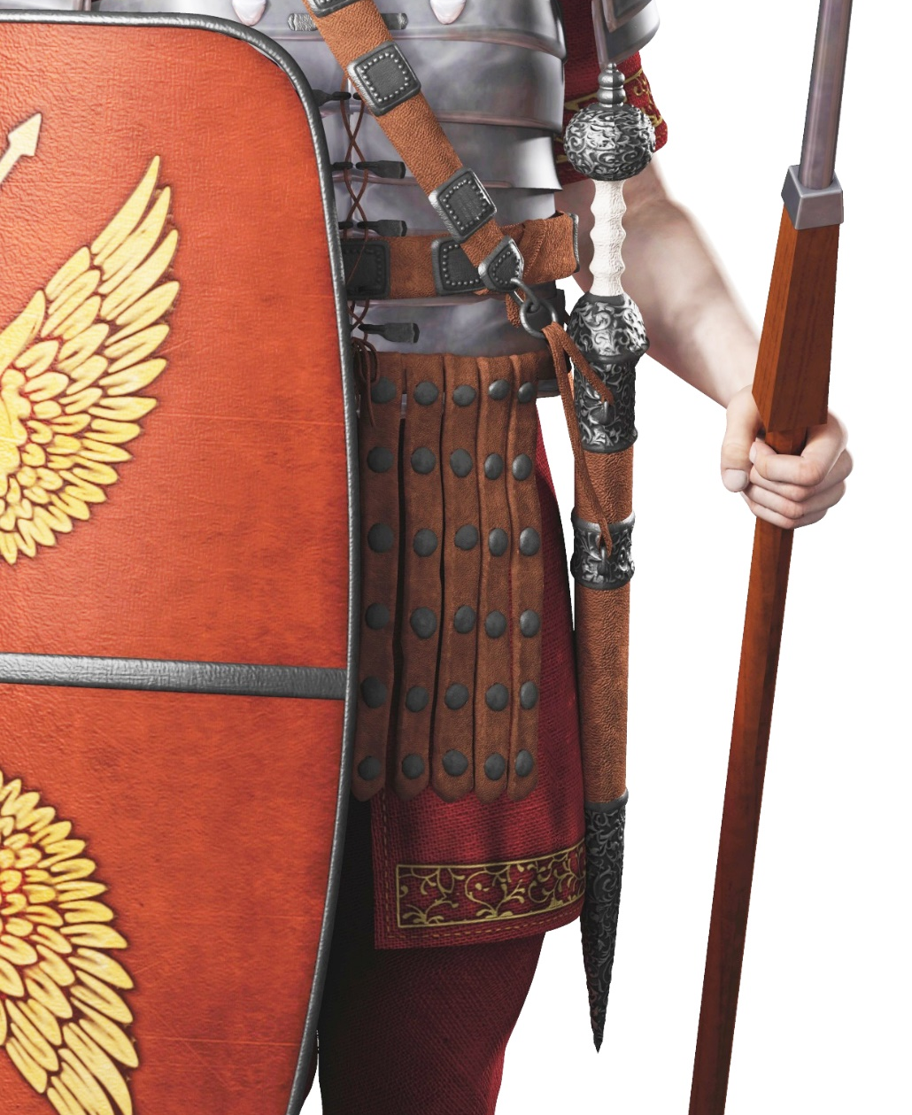
“Take the SWORD OF THE SPIRIT which is the WORD OF GOD.”
(Ephesians 6:17)
PURPOSE:
We use this offensive weapon of the spoken Word of God just as Jesus did in the wilderness when He said to Satan, “Be gone, Satan!”
Sword of the Spirit — the spoken Word of God

Slide 52
We declare God’s Word to the enemy.
Spiritual Warfare
Isaiah 49:2
He has made My mouth like a sharp sword,
In the shadow of His hand He has concealed Me;

Slide 53
Extremely lethal Roman sword symbol for the Word of God
Spiritual Warfare
Double-edged, sharp, greatly feared
Never left his side
A primary offensive weapon
Hebrews 4:12 (ESV)
For the word of God is living and active, sharper than any two-edged sword, piercing to the division of soul and of spirit, of joints and of marrow, and discerning the thoughts and intentions of the heart.

Slide 54
Activating the “the Sword of the Spirit” (Ephesians 6:17)
APPLICATION:
Speak an appropriate verse against the lie or strategy of the enemy, and it will destroy Satan’s plan against you.

Slide 55
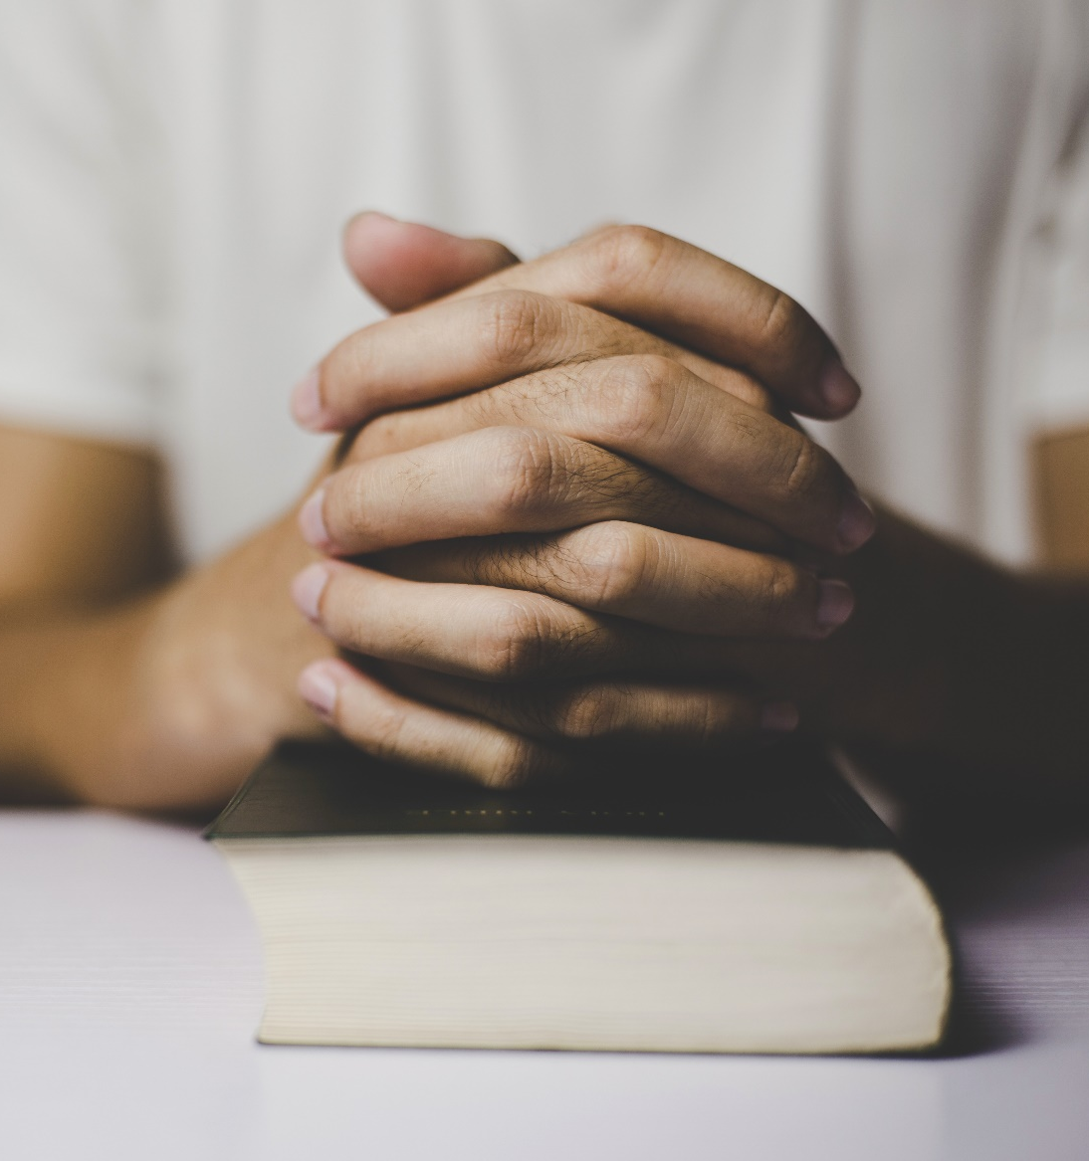
“PRAY at all times in the Spirit and be on the alert and make petition for all the saints.”
(Ephesians 6:18)
PURPOSE OF PRAYER FOR BATTLE:
Prayer is communication with God in praise, thanksgiving, confession, petition, intercession and LISTENING. Prayer keeps us from falling into enemy traps. We get our orders for all spiritual warfare in prayer.

Slide 56
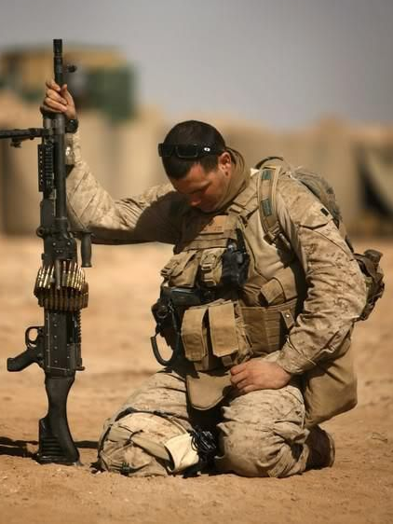
Jesus admonishes us to pray.
Prayer is the most lethal far-reaching weapon of our armor.
Spiritual Warfare
Matthew 26:41
Keep watching and praying, that you may not enter into temptation; the spirit is willing, but the flesh is weak.

Slide 57
Activating the weapon of “prayer”
(Ephesians 6:18)
APPLICATION:
We pray for boldness to fearlessly declare the Gospel to unbelievers.
We pray for boldness to speak against all enemy opposition in our minds or external circumstances.
We stay alert to pray for the needs of our fellow brothers and sisters.

Slide 58
How do we put on the Armor?
Belt of Truth
Breastplate of Righteousness
Feet sandaled and ready to go and proclaim the Gospel of Peace
Shield of Faith
Helmet of Salvation
Sword of the Spirit — the Word of God
Prayer
Spiritual Warfare

Slide 59
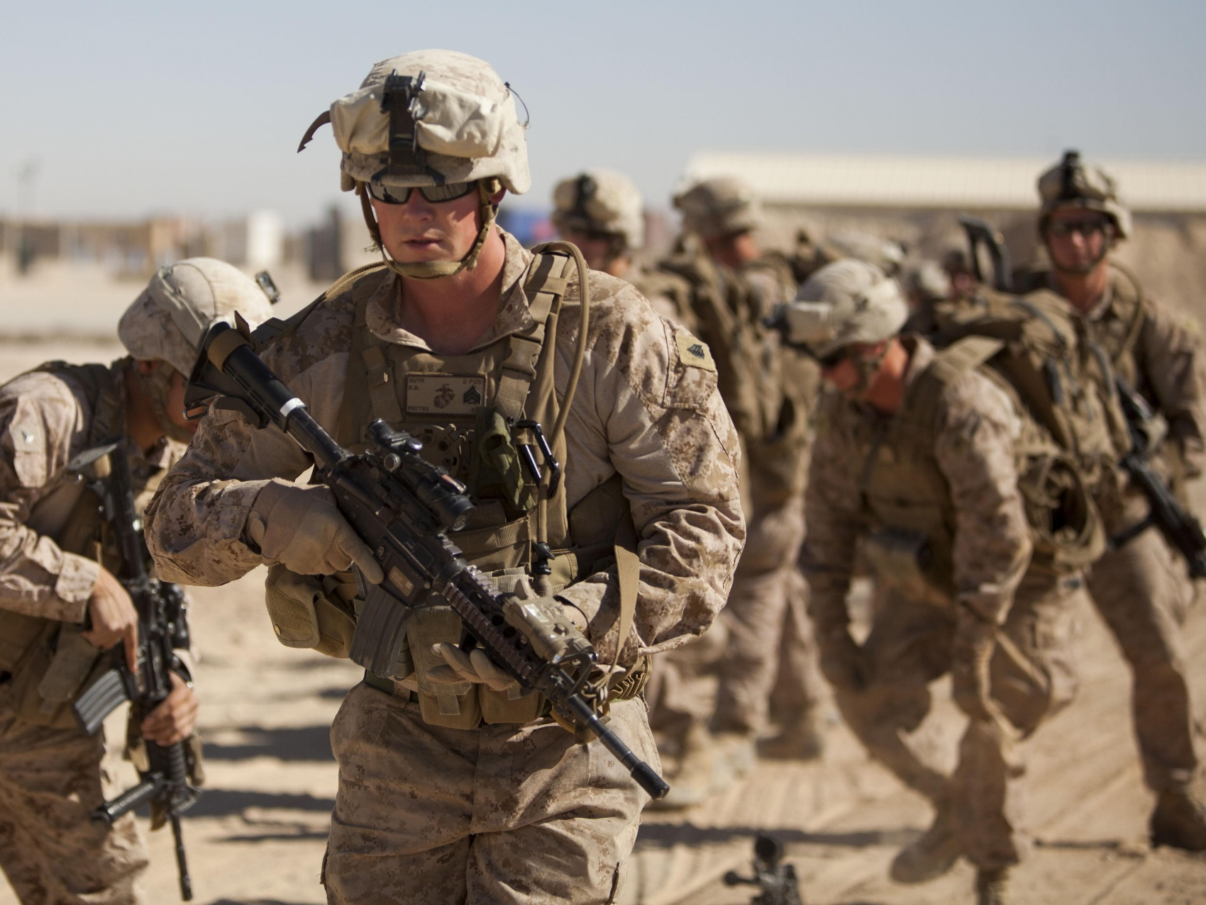
Is this how the enemy sees you?
Luke 10:19
Behold, I have given you authority to tread on serpents and scorpions, and over all the power of the enemy, and nothing will injure you.

Slide 60
Psalm 18: 32-37
The God who girds me with strength
And makes my way blameless?
He makes my feet like hinds' feet,
And sets me upon my high places.
He trains my hands for battle,
So that my arms can bend a bow of bronze.
You have also given me the shield of Your salvation,
And Your right hand upholds me;
And Your gentleness makes me great.
You enlarge my steps under me,
And my feet have not slipped.
I pursued my enemies and overtook them,
And I did not turn back until they were consumed.

Slide 61
Lighthouse Ministry International
Home Office
P.O. Box 120297 | St. Paul, MN 55112
For Ministry Appointments
(651) 483-0888
Email
info@LighthouseMinistryIntl.org
Web
LighthouseMinistryIntl.org

